Slide 1
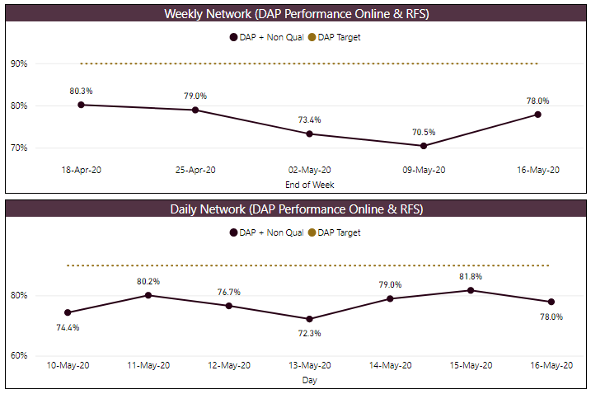
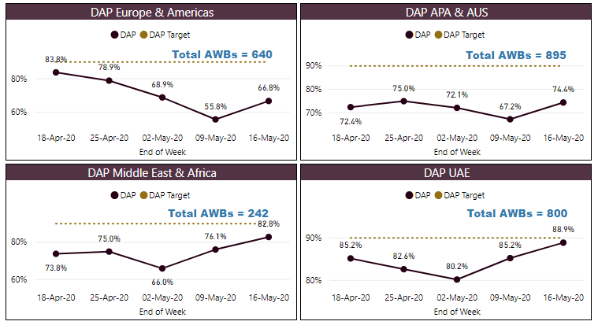
DELIVERED AS PROMISED
Network Actuals
Regional Actuals
DAP = “Deliver As Promised” – NFD on time (system issues not counted as failures to Customer)
RFS = “Road Feeder Service” – Stations with trucking contracts (Europe & US)
DAP target is 90% by end of 2020
Actions | Initiatives | Escalations
Last week DAP (78.0%), a increase of 7.5% from the previous period.
At the Regional level: EUR & AME (+11.0%), ME & AFR (+6.7%), APA & AUS (+7.2%) and UAE (+4.7%)
DAP YTD is 84.1%

Slide 2
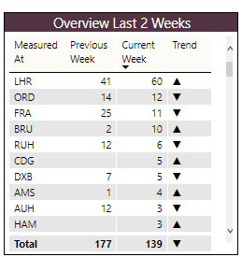
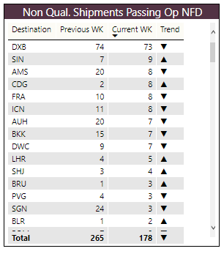
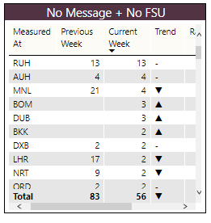
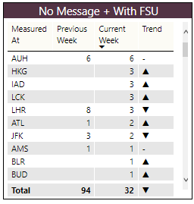
DELIVERED AS PROMISED | BACKGROUND INFO
No Messages Failures for DAP
Late Event Failures for DAP
Non Qual. Shipments Passing Op NFD
No FSU Received (GHA Issue)
FSU Received (System Issue)
Notes for Week
Total “No Message” failures decreased by 50.3% from last period. Total “Late Event” failures decreased by 21.5% from last period
RUH was the top “No Message” (with no FSU received) failure station. and AUH was the top “No Message” failure station last period
LHR (1ST Last Period) and ORD (3RD Last Period ) are the top two “Late Event” error stations. Failures changed by +46.3% and -14.3% respectively from last period.

Slide 3
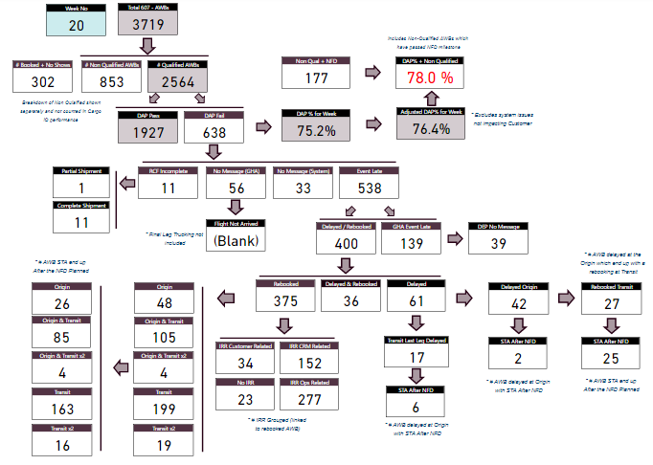
DELIVERED AS PROMISED | FAILURE BREAKDOWN

